Slide 1
Accessing the Curriculum for Diverse Learners
Prompting – putting it all together

Slide 2
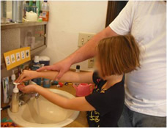
What is the adult demonstrating?

Slide 3
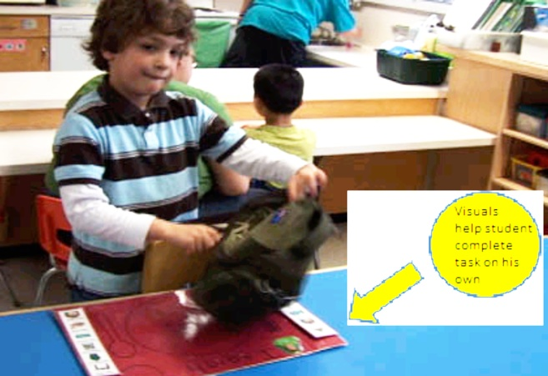
How can this visual prompt systematically be faded?

Slide 4
Types of Prompts
Natural Cue
Modeling
Physical
Gesture
Verbal
Visual

Slide 5
Gradients within a prompt
Gestures
2.Moderate?
3.Low?
1.High?

Slide 6
Gradients within a prompt
Verbal
2.Moderate?
3.Low?
1.High?

Slide 7
Gradients within a prompt
Visual
2.Moderate?
3.Low?
1.High?

Slide 8
Gradients within a prompt
Modeling
2.Moderate?
3.Low?
1.High?

Slide 9
Gradients within a prompt
Physical
2.Moderate?
3.Low?
1.High?

Slide 10

What type of prompt is this educator demonstrating?

Slide 11

What type of prompt is this educator demonstrating?

Slide 12
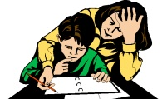
How can the various prompts be faded?

Slide 13
Printing Resources
Adaptive Devices
Pencils and other markers
Grips: commercial and homemade
Weighted writing utensils
Raised Line Paper
Kinesthetic Approaches
Computer programs / apps
Teaching Resources:
Printing without tears
Printing like a pro

Slide 14
Embedded Learning Opportunities
For printing name:
Worksheets
Sign in / sign out routines
Name on art project
What else?
Alternatives to printing:
Using a label (student peels and places on spot)
Name stamp
Letter stamps
What else?

Slide 15

What needs your attention?

Slide 16

Activity

Slide 17

Activity
Follow the complete process for the assigned activity
Rotate roles
Practice the areas who have identified you need to strengthen

